Slide 1
Go Generics: First Impressions
@nikolaydubina 2022-04-27

Slide 2
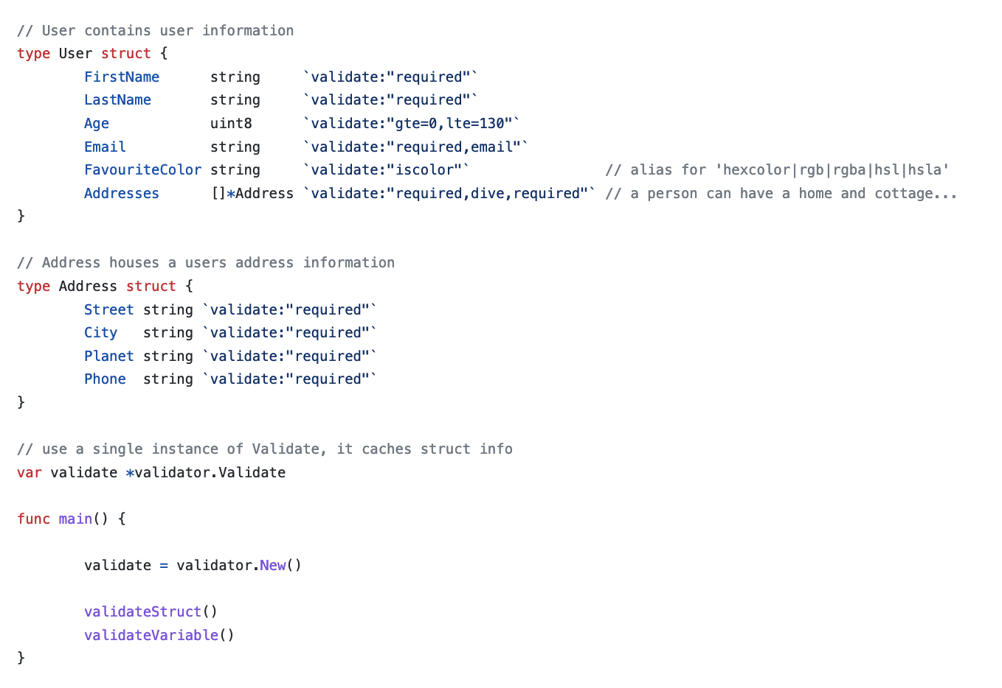
Validation with go-playground
github.com/go-playground/validator
Define as struct tags
Initialize Validator instance
Validator constructed with reflection
Very fast 100s of ns

Slide 3
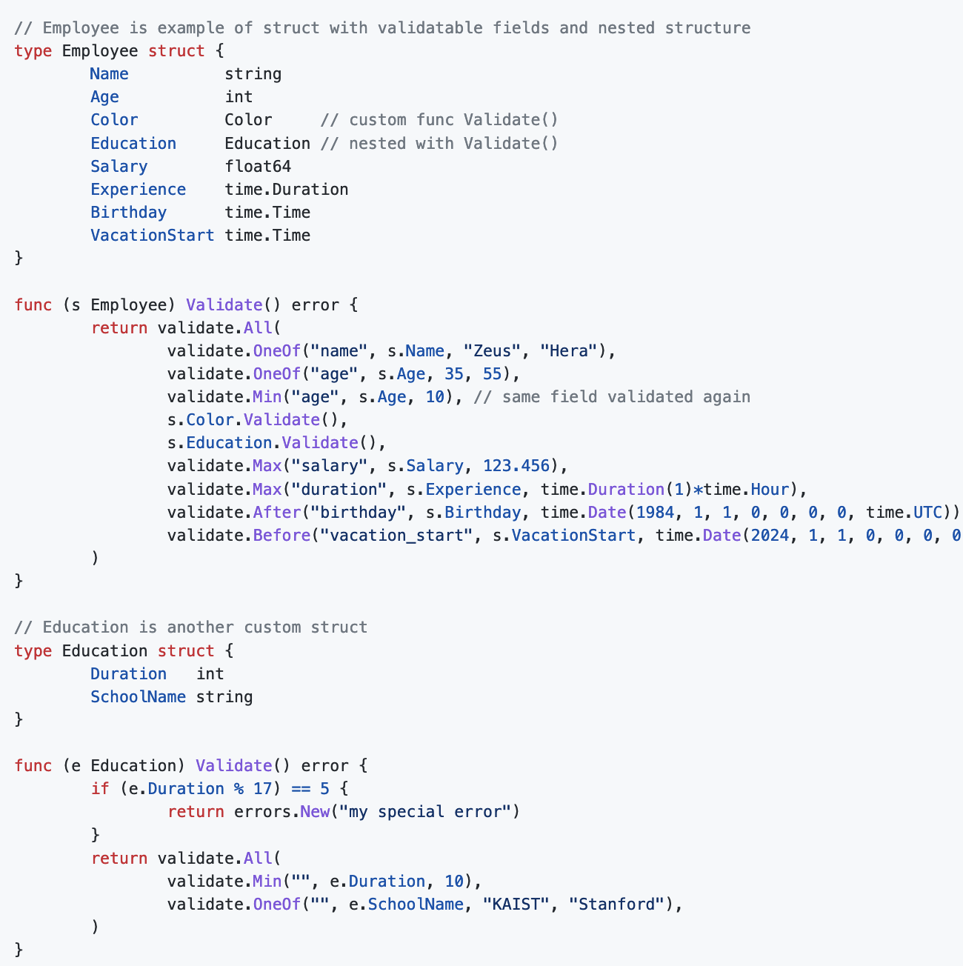
Validation with native Go constructs
github.com/nikolaydubina/validate
Fast and small LOC validation
No reflection
No gencode
No tags
Composable
Short notation
How convenient, small LOC, and fast can it be?

Slide 4
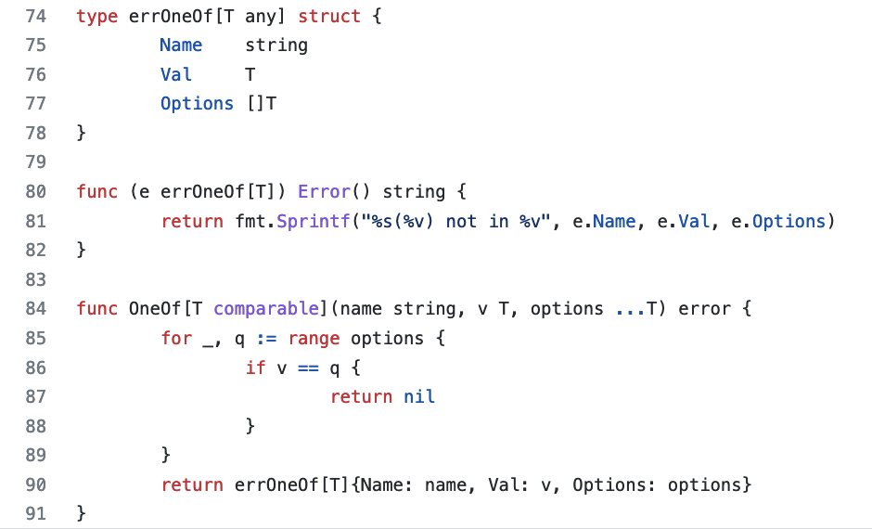
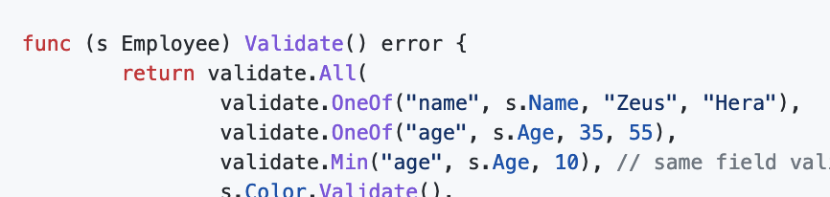
Learnings: Go generics work well
.. and barely noticeable

Slide 5
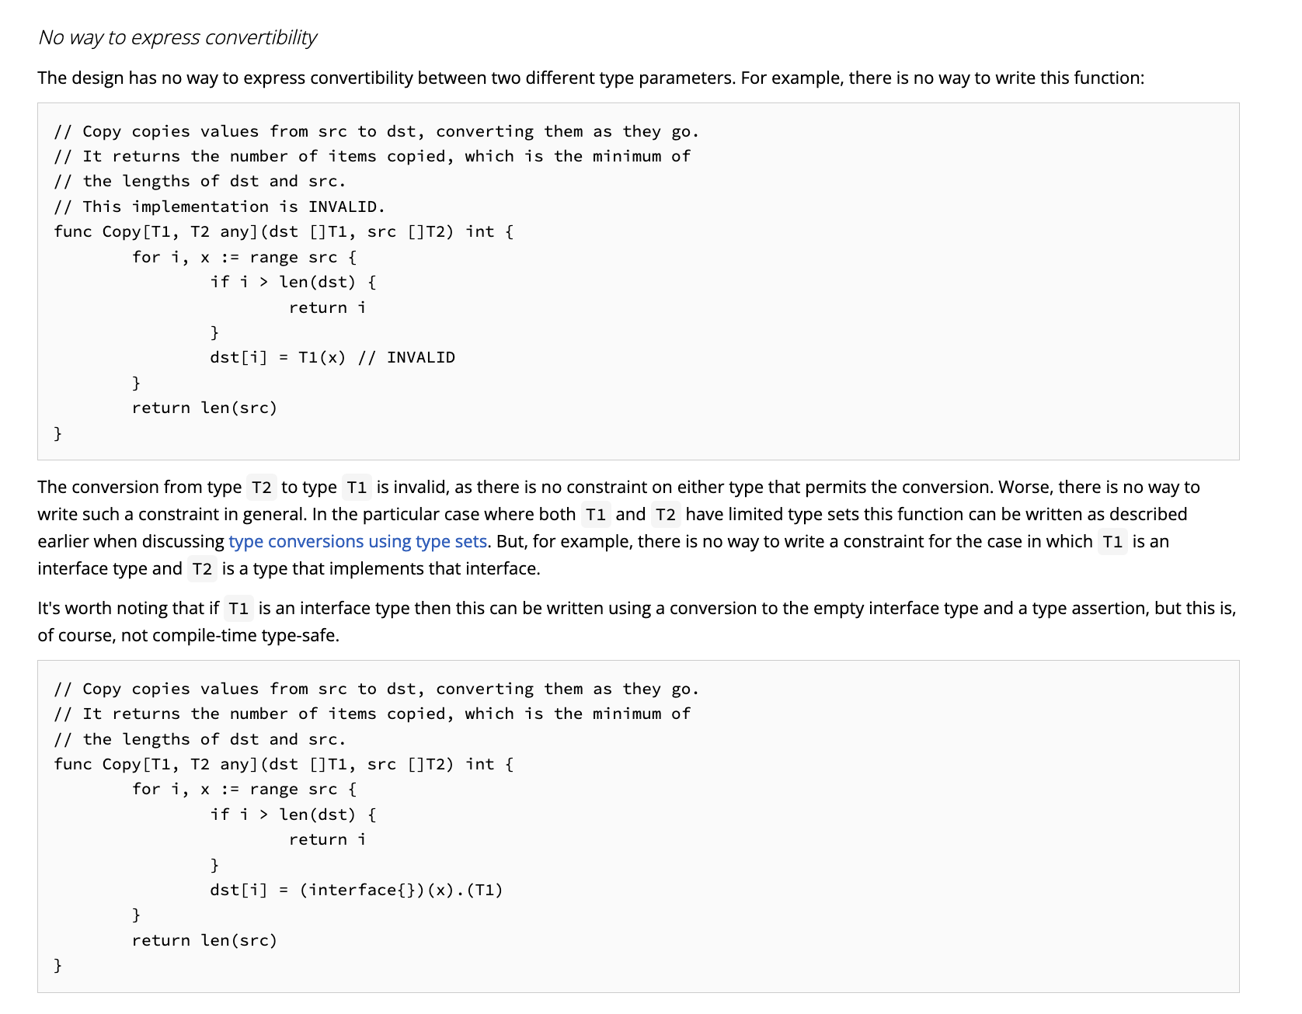
Learnings: Go generics have many limitations
Can not convert T1 to T2
Ref. https://go.googlesource.com/proposal/+/refs/heads/master/design/43651-type-parameters.md#omissions

Slide 6
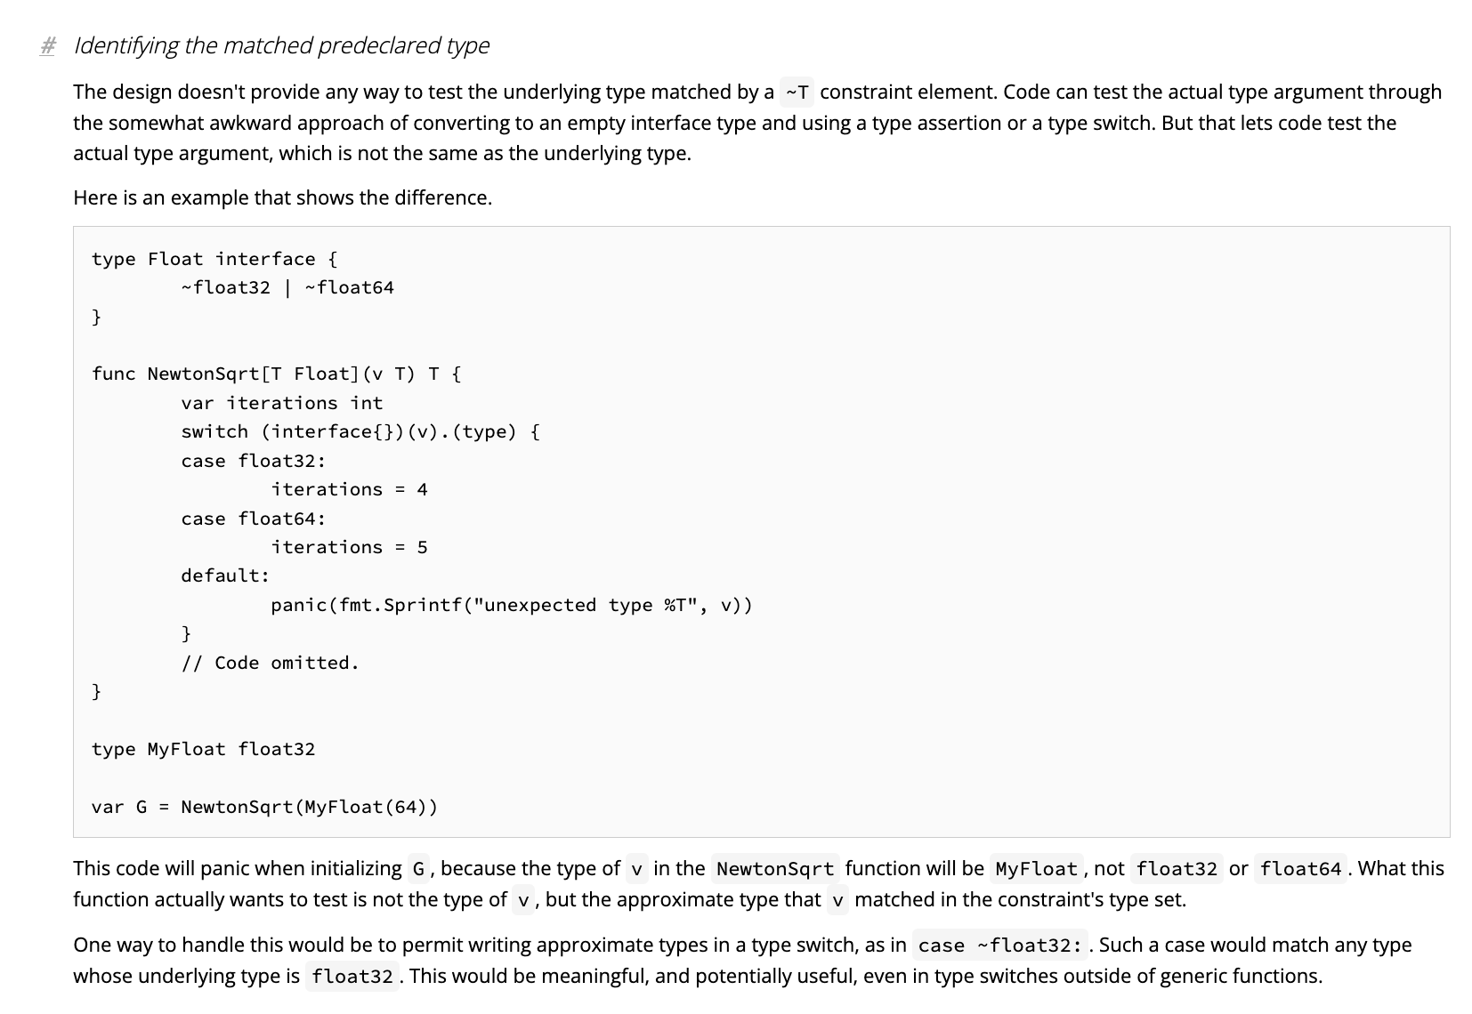
Learnings: Go generics have many limitations
Can not convert T1 to T2
Can not identity matched replaced type
Ref. https://go.googlesource.com/proposal/+/refs/heads/master/design/43651-type-parameters.md#omissions

Slide 7
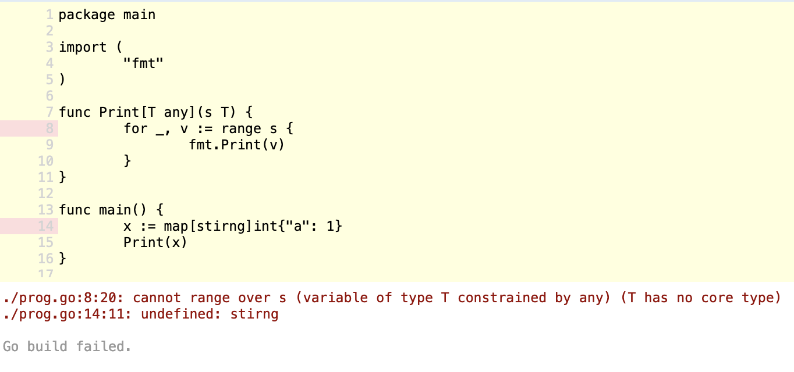
Learnings: Go generics have many limitations
Can not convert T1 to T2
Can not identity matched replaced type
T can not be slice, nor array, not map
Can not iterate over it
Can not access at index

Slide 8
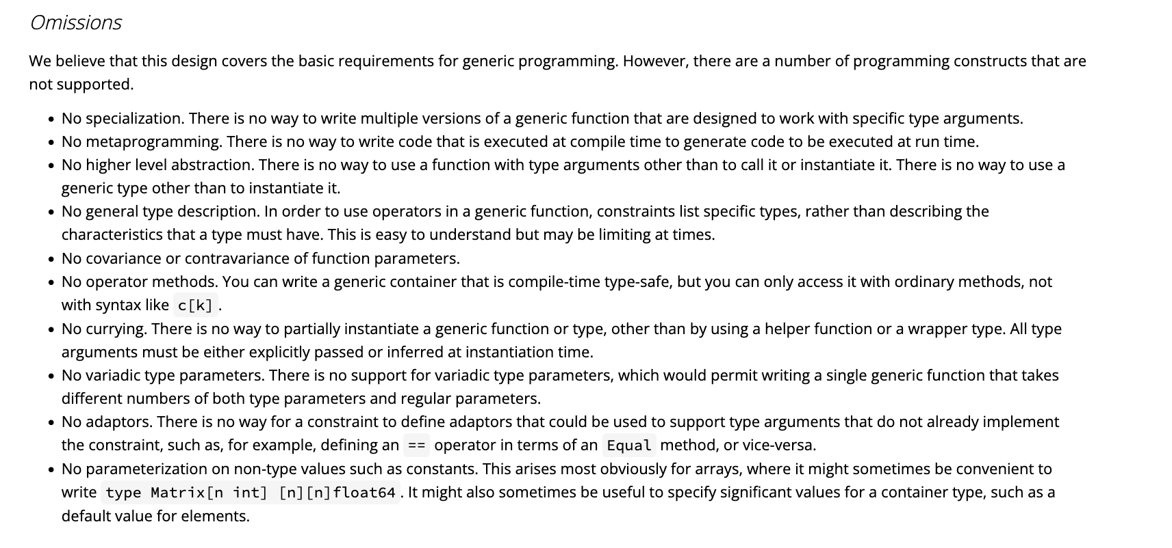
Learnings: Go generics have many limitations
Can not convert T1 to T2
Can not identity matched replaced type
T can not be slice, nor array, not map
..and many more
Ref. https://go.googlesource.com/proposal/+/refs/heads/master/design/43651-type-parameters.md#omissions

Slide 9
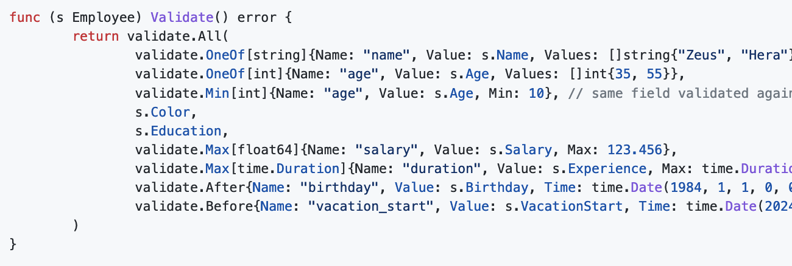
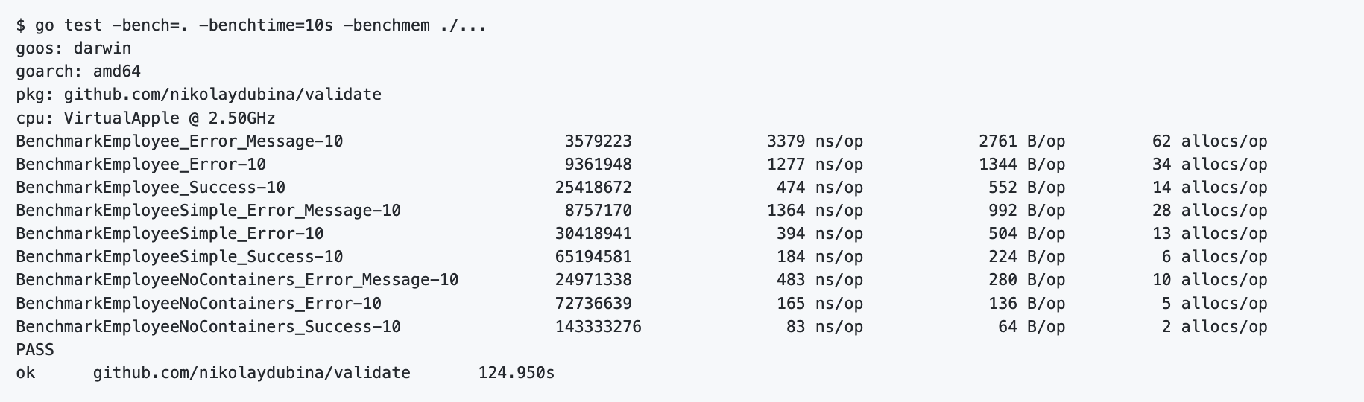
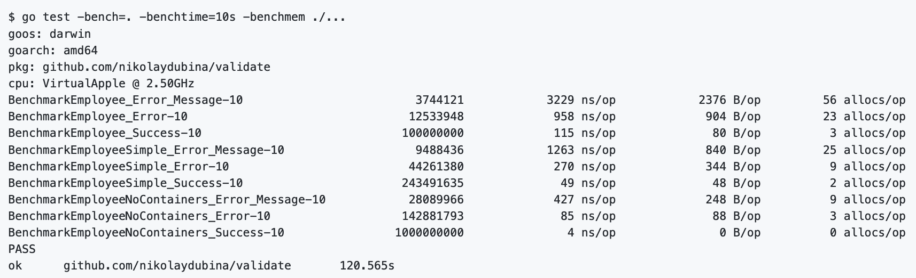
Learnings: wrapping functions slows down
Time increases and mallocs too

Slide 10
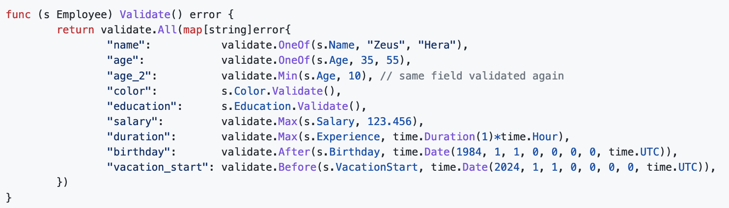
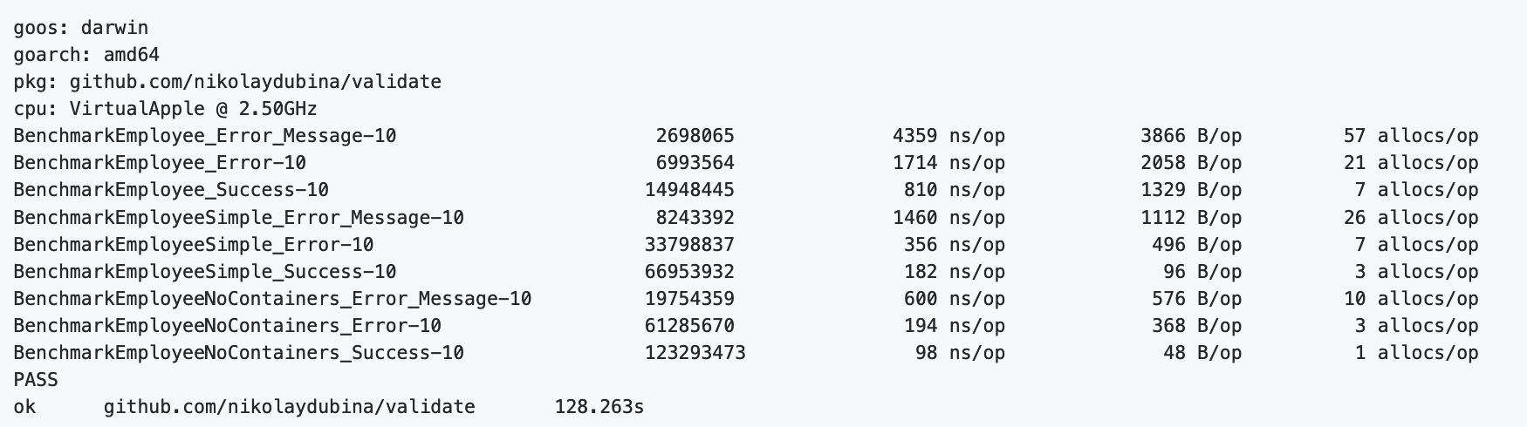
Learnings: passing functions through maps slows down
Overhead of indirection and map is higher than saving from strings

Slide 11
Learnings: fmt is slow + lazy execution
Hot-path: error does not happen
Avoid mallocs when error not happens
Terminate ASAP
Lazy execution in Go is possible
fmt is expensive
create container needed for rendering
invoke render only to when Error() invoked
try to render with non-fmt first errors.New is fast
More benchmarking errors https://github.com/nikolaydubina/go-bench-errors

Slide 12
Final outcome?
Used generics only for function parameters
Functions instead of interfaces
Fairly fast
~90LOC ok syntax
Generics do reduce duplication for basic types
Generics are not as flexible

Slide 13
Official Go recommendation
“..should avoid type parameters until you notice that you are about the write the exact same code multiple times.”
Don’t replace interface types with type parameters
Don’t use type parameters if method implementations differ
Ref. https://go.dev/blog/when-generics

Slide 14
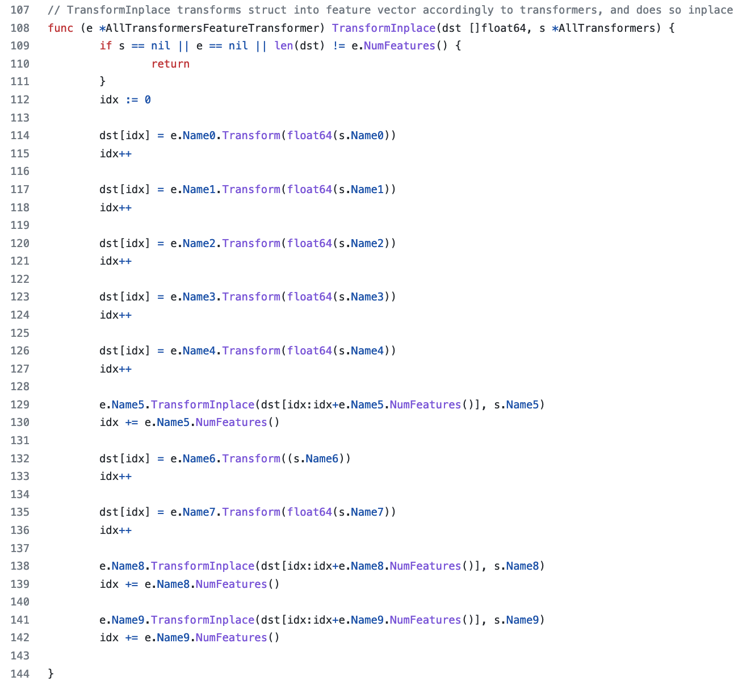
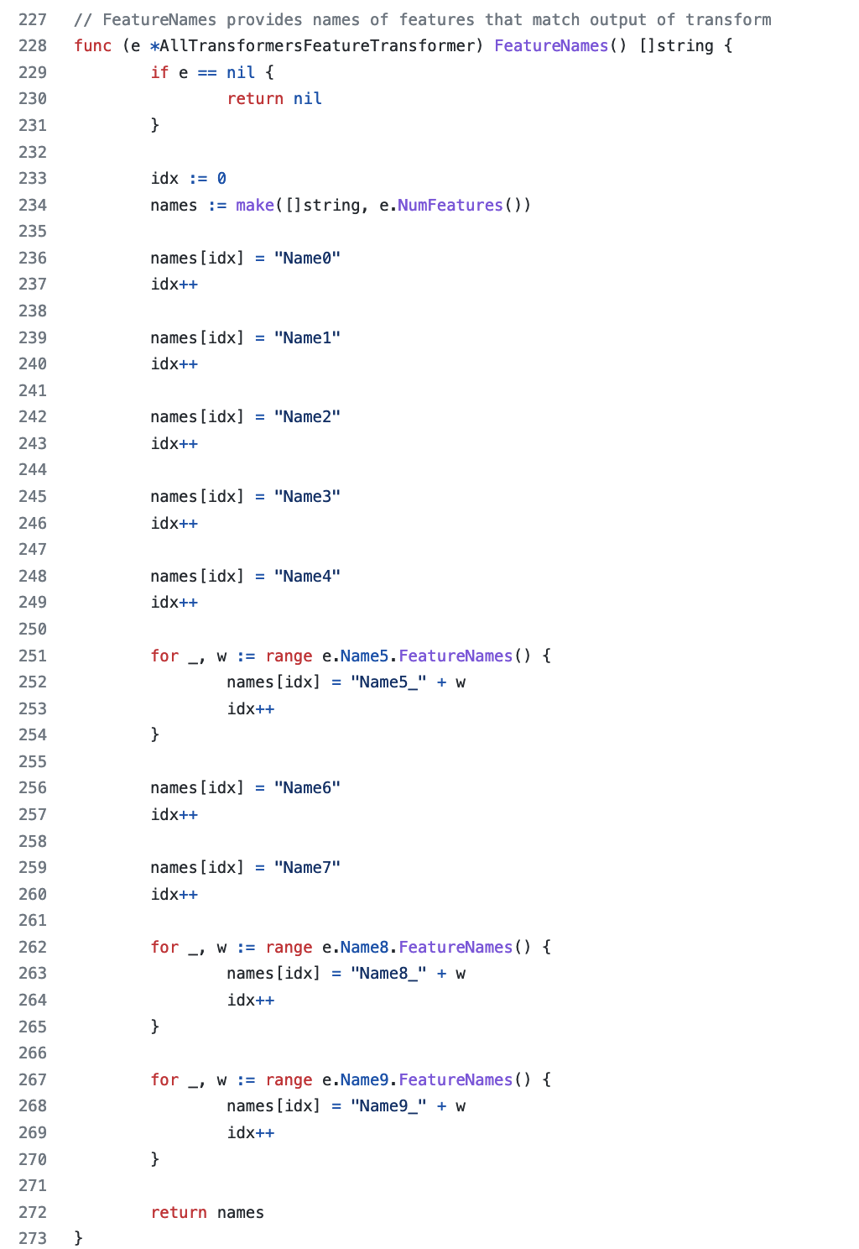
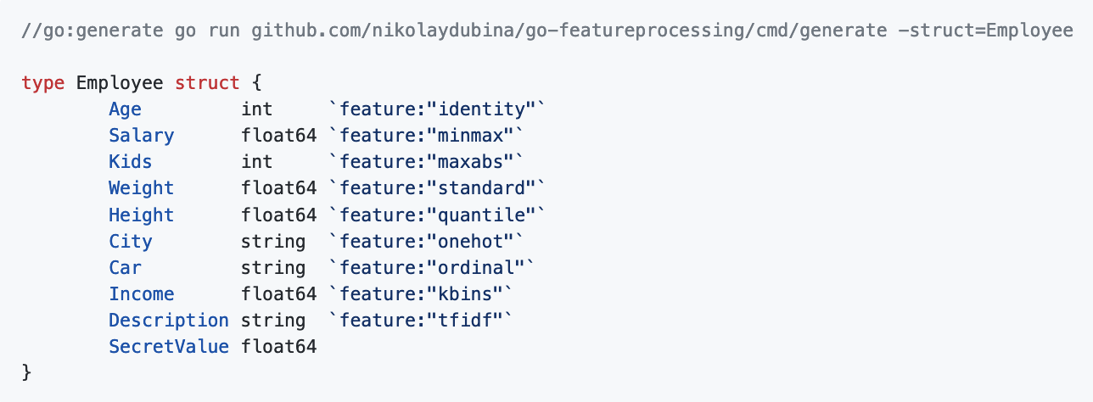
Other mechanisms: go:generate and tags
https://github.com/nikolaydubina/go-featureprocessing
Generate in-place indexing for invocations
For speed + json tags

Slide 15
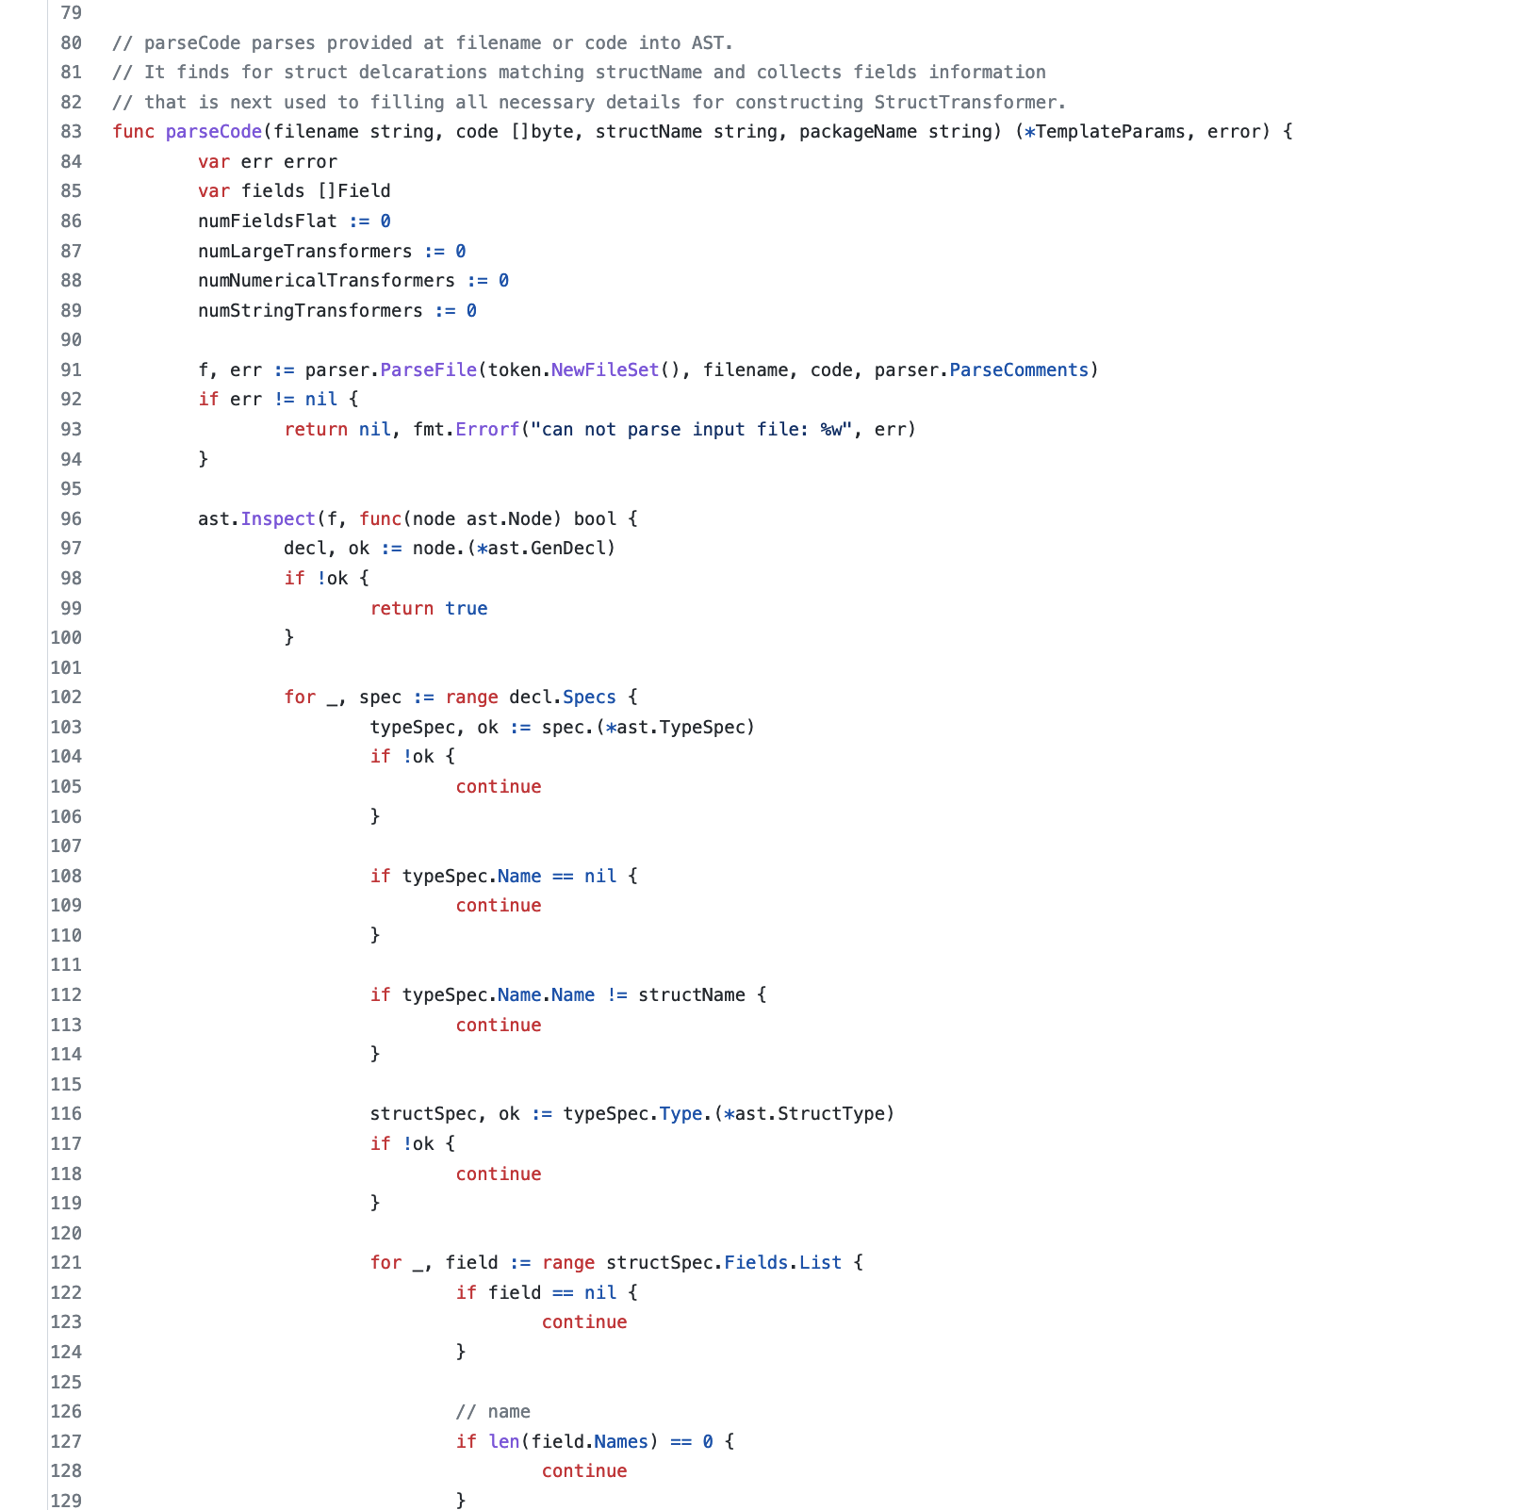
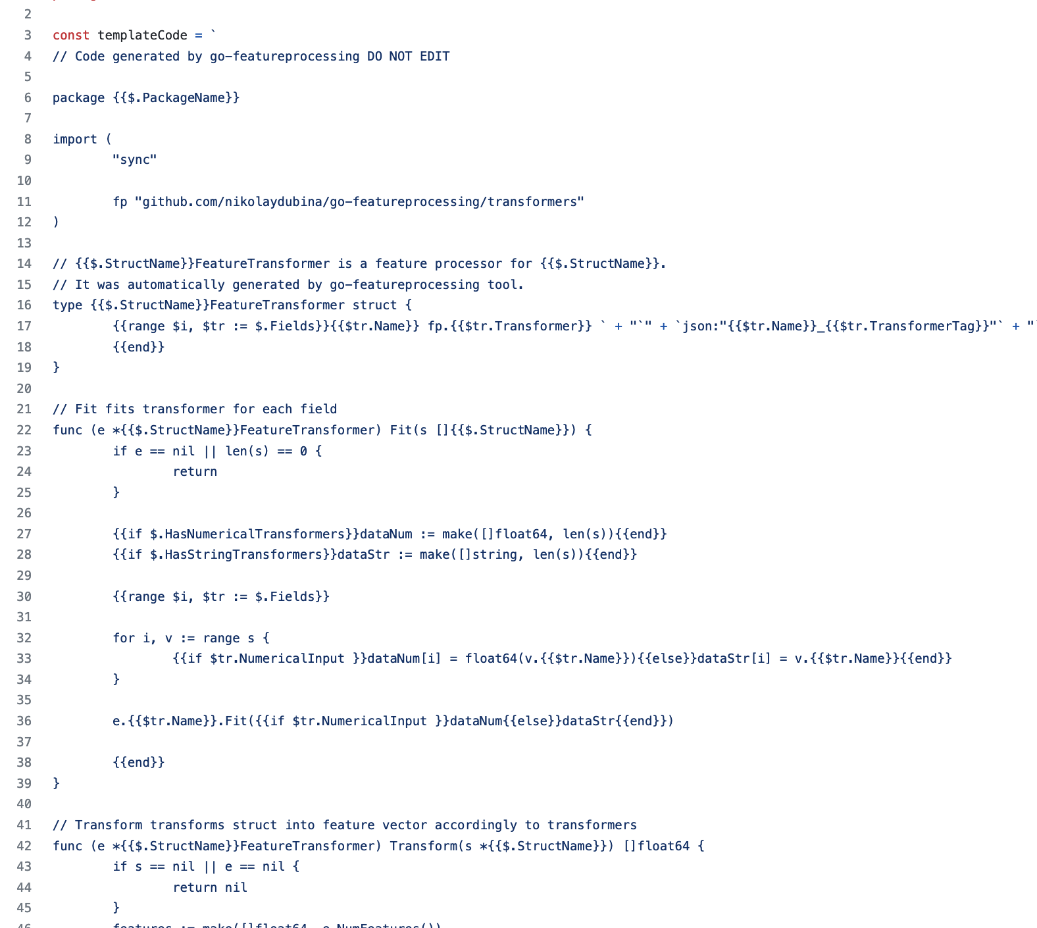
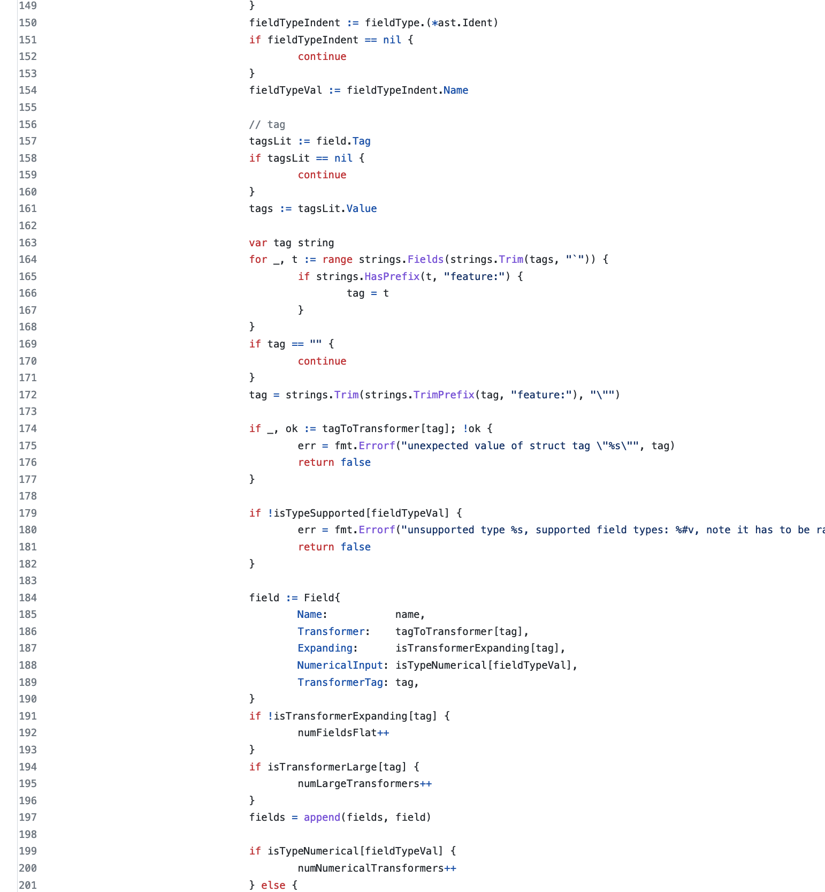
Other mechanisms: go:generate
https://github.com/nikolaydubina/go-featureprocessing
Very fast
Functions get inlined
However!
Laborious to write AST generator

Slide 16
Thank you!

